Slide 1
Perimeter Trap Crops
Rocky Creek Valley Farm – Gary Wenig

Slide 2
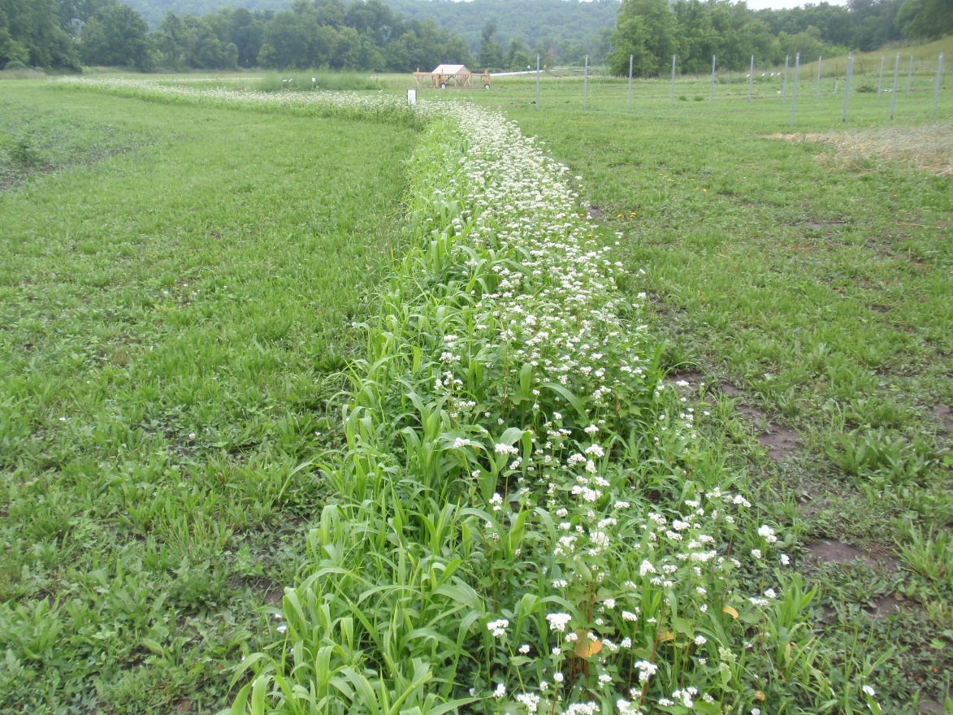

Trap Crops
Sorghum Sudan Grass
Buckwheat
Millet
Fennel, dill, yarrow, coriander, tansy, buckwheat & millet attracts lady bugs, lacewing, hover flies, parasitic mini-wasps, tachinid flies. These are beneficial insects that kill the bad pests in your garden.

Slide 3
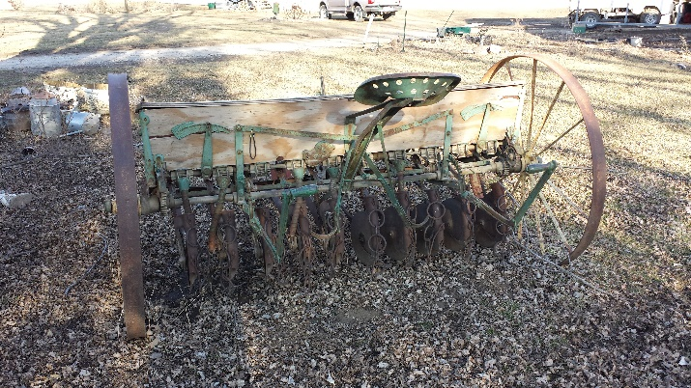
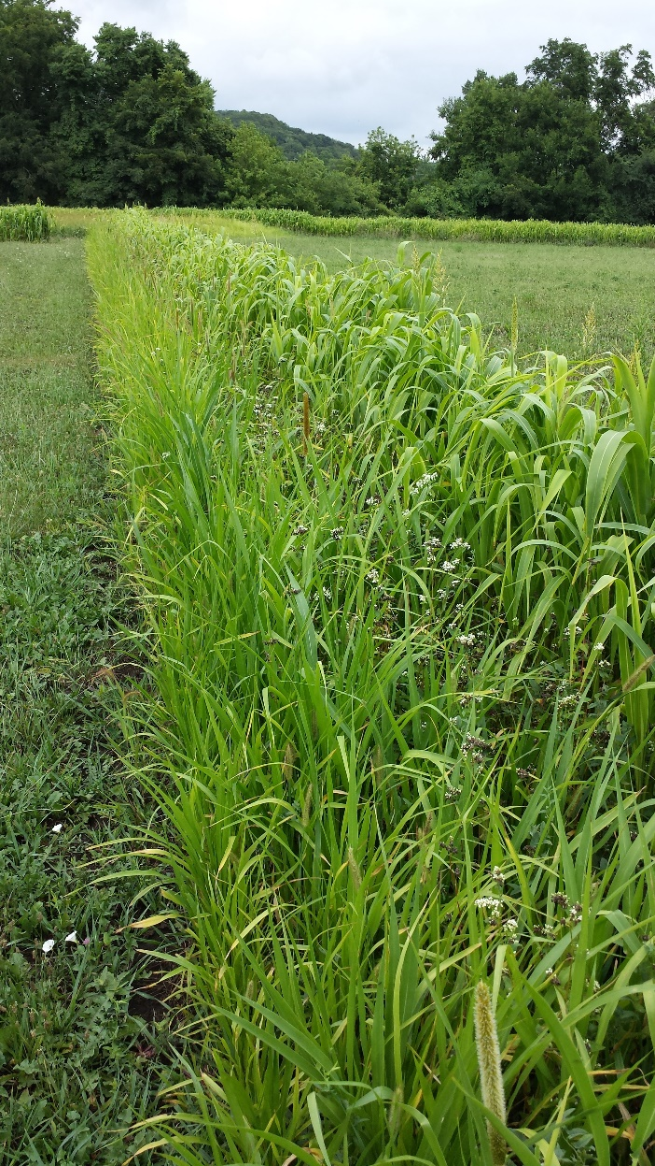
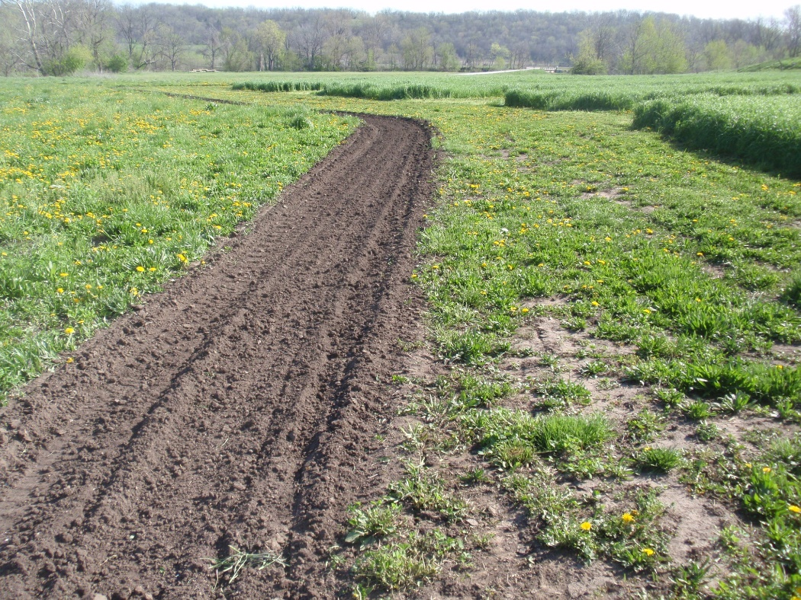
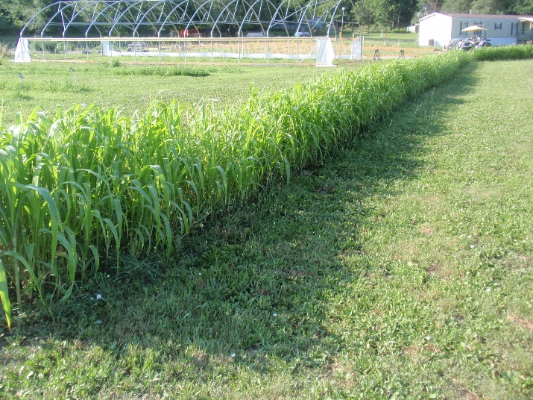
Prep & Planting
Millet, Buckwheat, Sorghum Sudan Grass

Slide 4
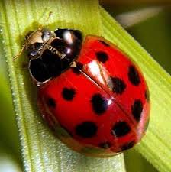
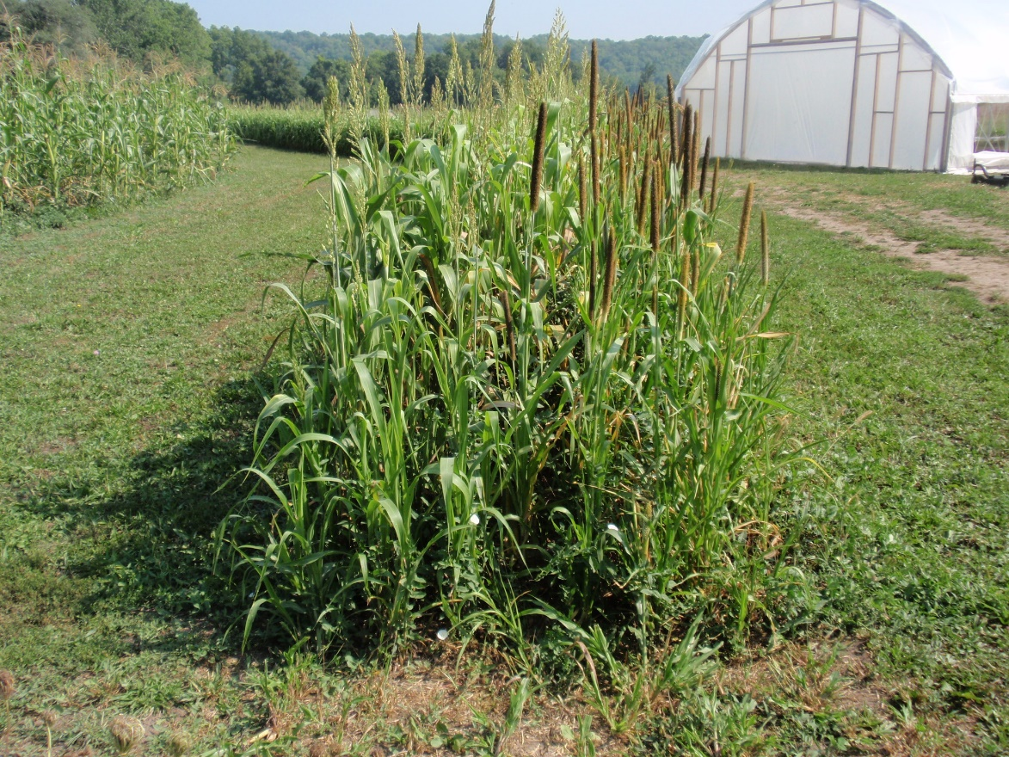
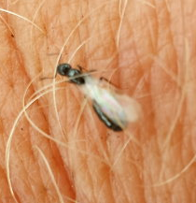
Beneficial Insects
Parasitic mini-wasps
Ladybug
Millet at maturity

Slide 5
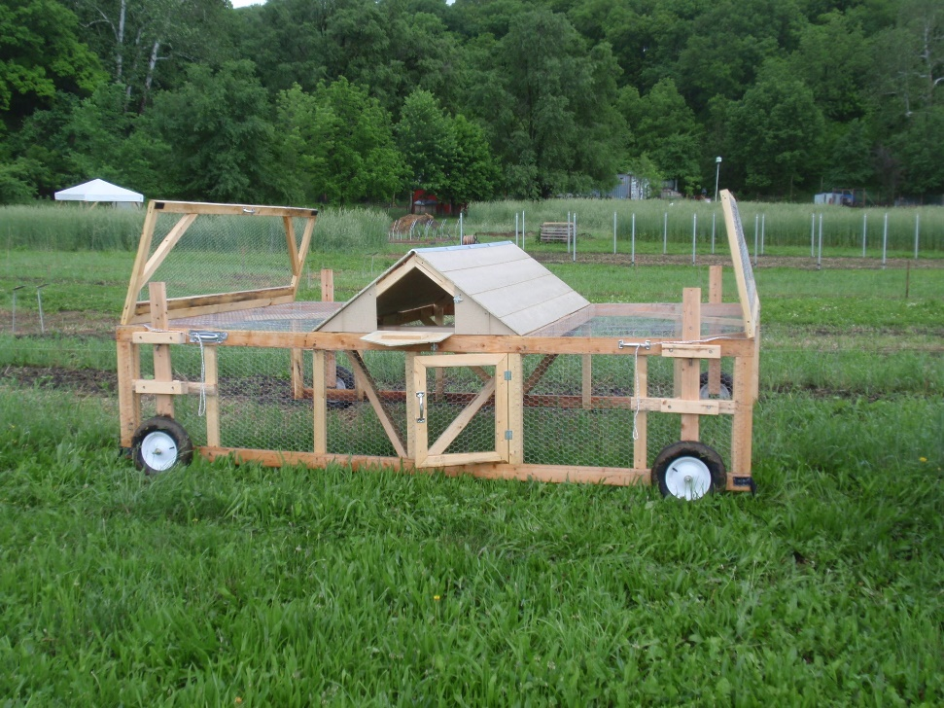
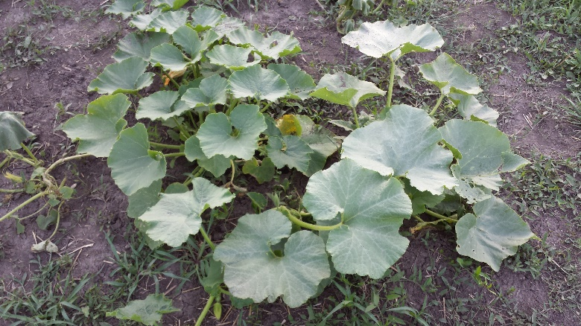
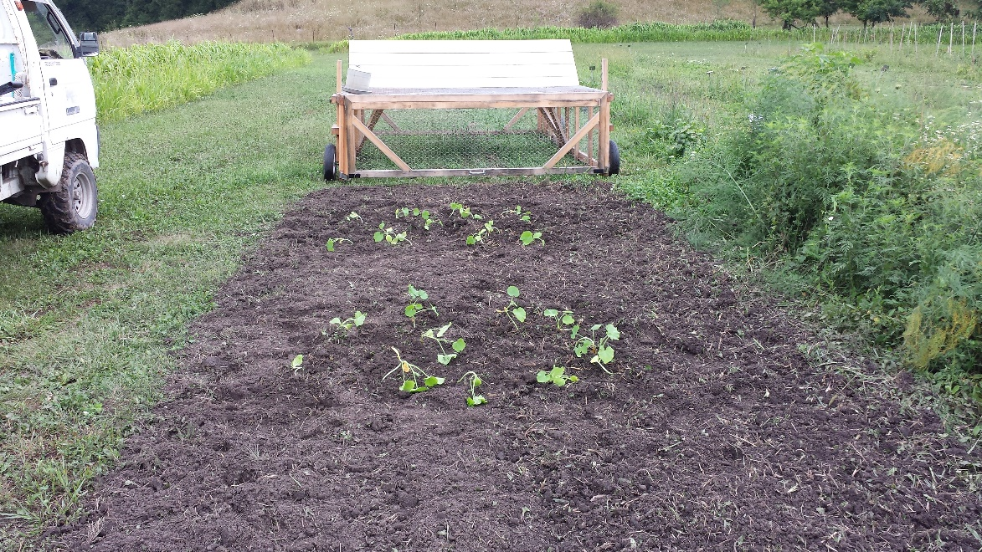
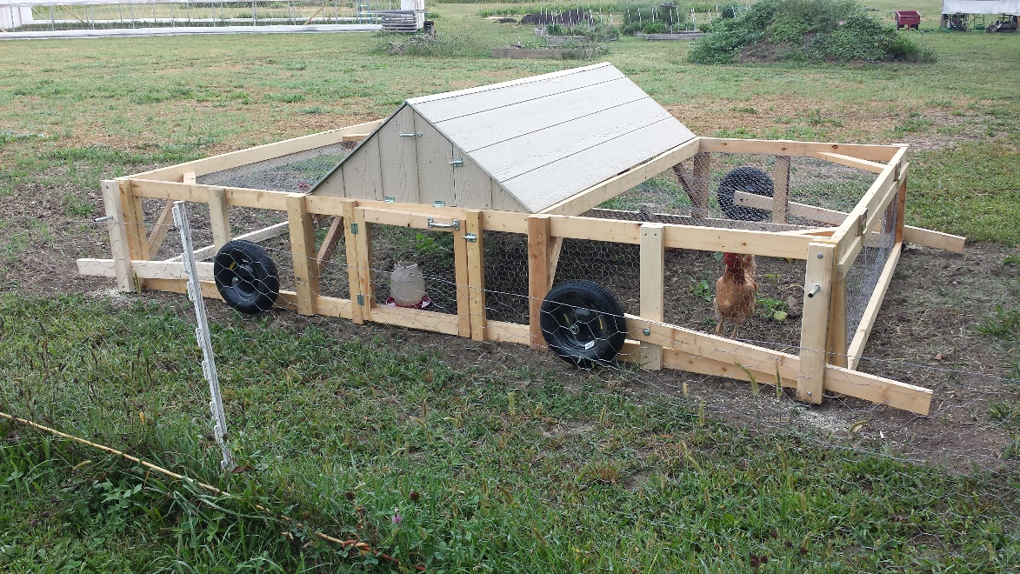
Blue Hubbard Sacrificial Plant
Attracts:
squash bugs & cucumber beetles

Slide 6
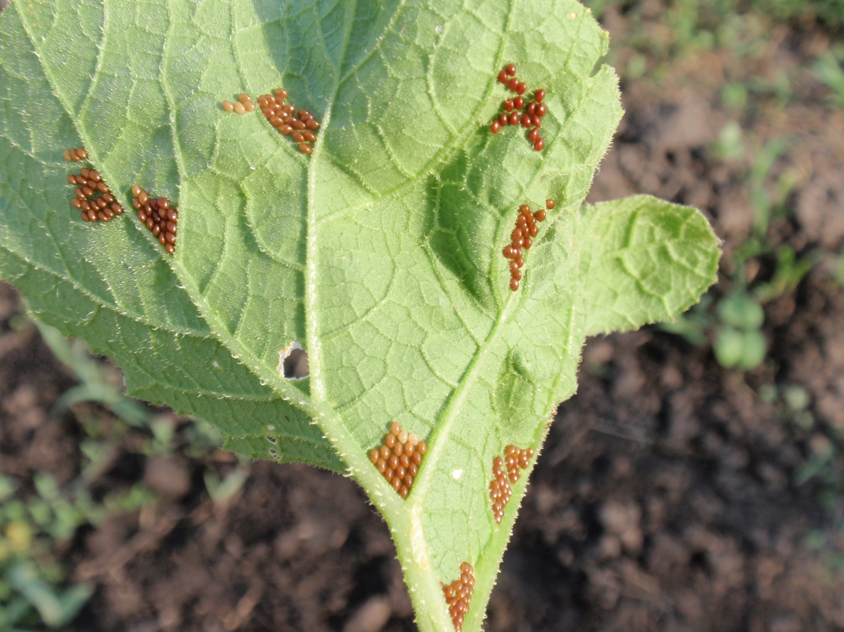
Reduced Pesticide Usages
Squash bug eggs
Procedural issue resolved
Ghost pepper experiment

Slide 7
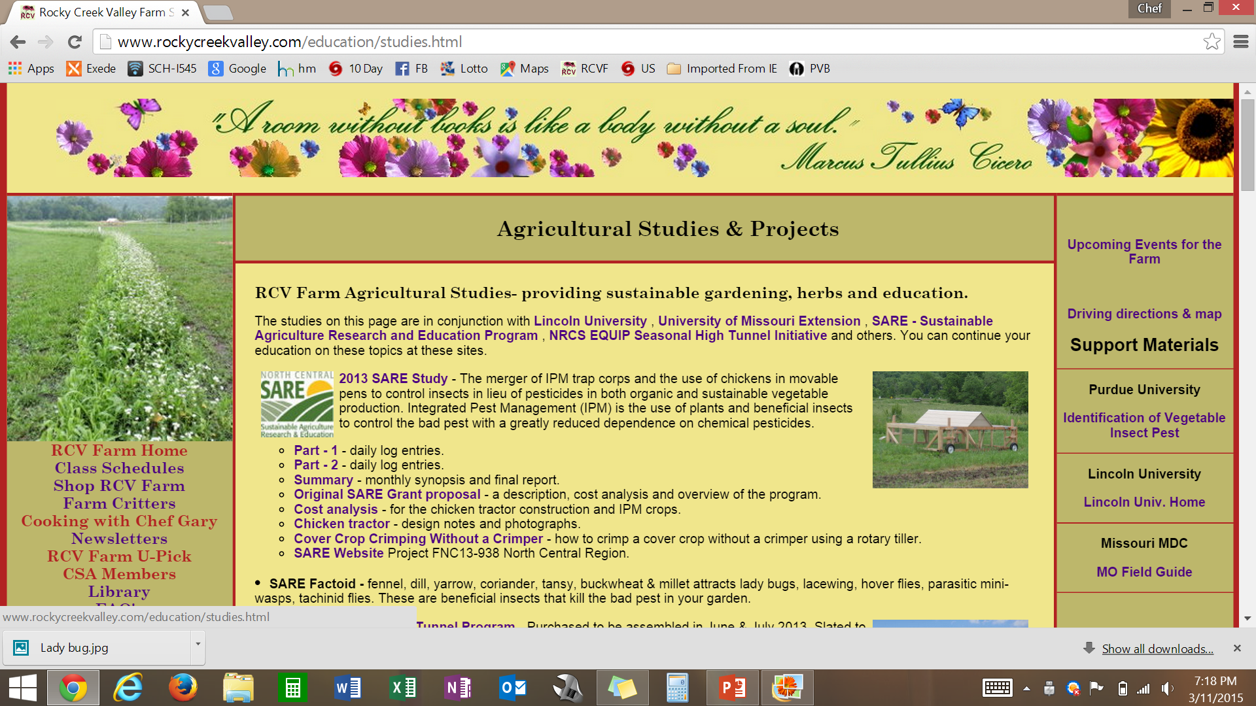
www.RockyCreekValley.com

Slide 8
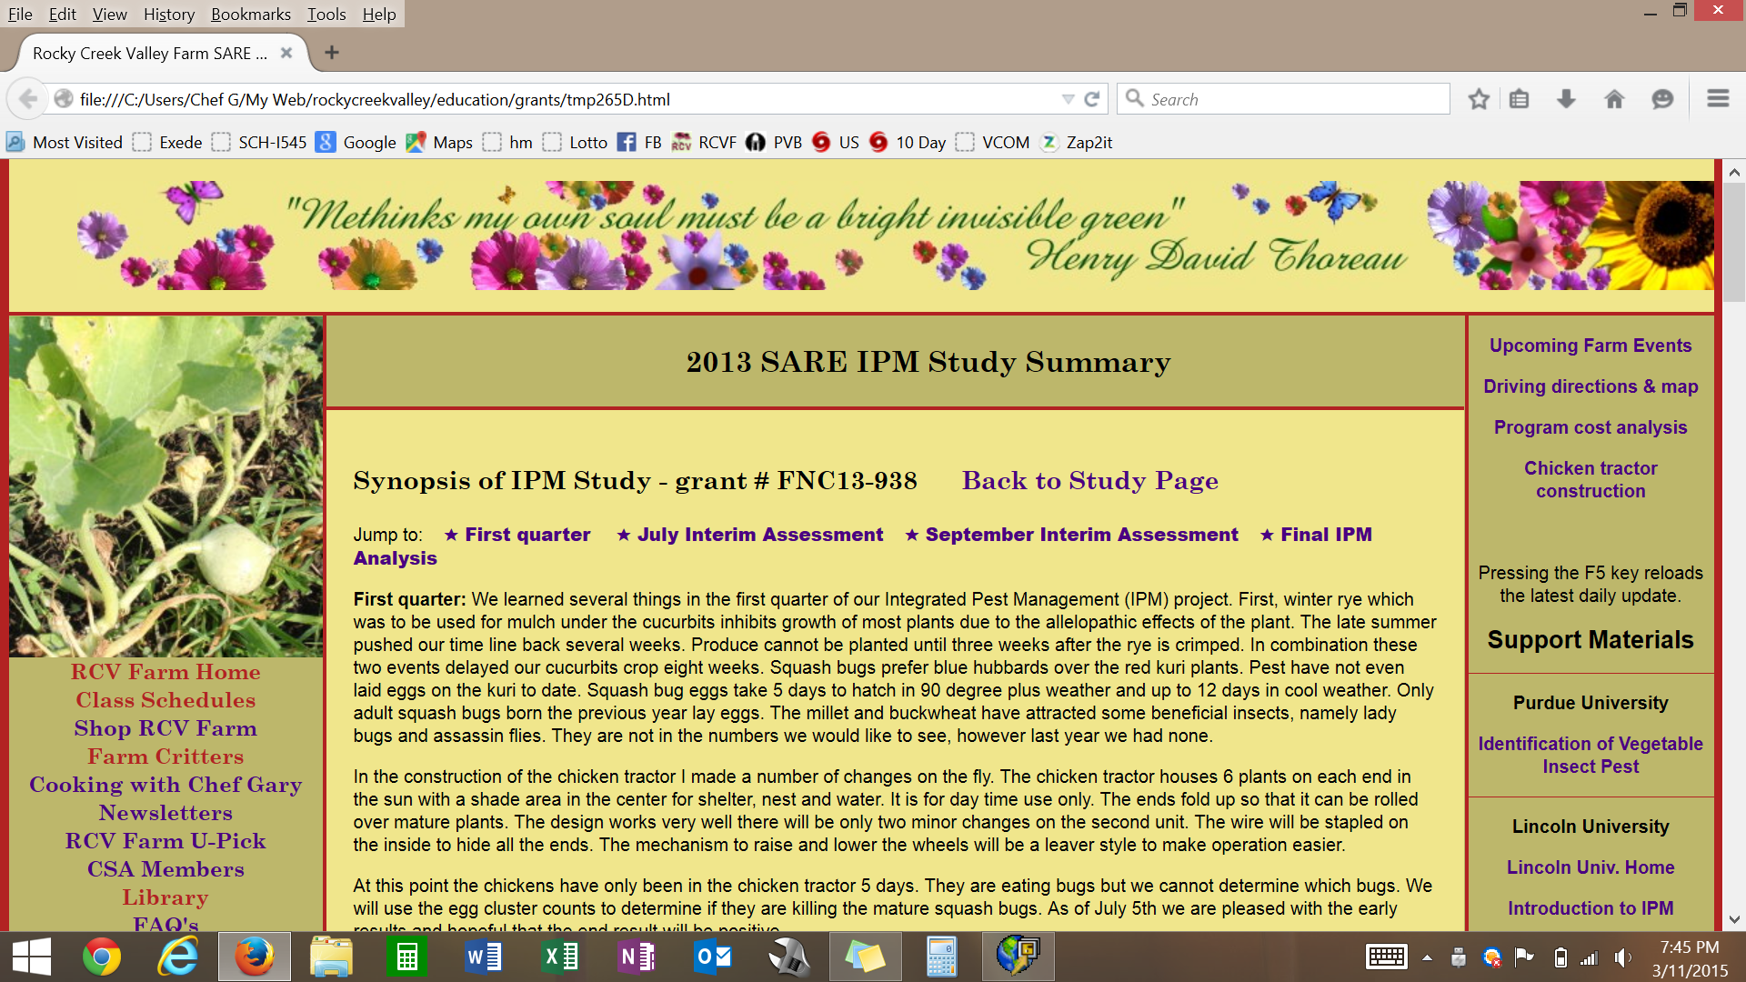
www.RockyCreekValley.com

Slide 9
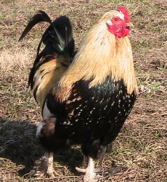
SARE IPM Summary
Perimeter trap crops are a 100% success story
Provides several alternative methods for pest control
Greatly reduces pesticide use
Highly useful for certified organic growers
Overall our IPM test was a great success
Thanks to: Dr. Pinero, Jacob Wilson, Susan Jaster

Slide 10
Perimeter Trap Crops
Rocky Creek Valley Farm
Questions

